Slide 1








London’s Health Day
Great Mental
Friday, 31 January 2025
Supporter’s Pack
December 2024

Slide 2


Contents
  Introduction to Great Mental Health Day
  Spreading the word through your networks
  How to get involved
  Hosting your own event or activity
  Local spotlight
  Actions and next steps
  Appendix

Slide 3

Introduction to Great Mental Health Day
Overview of the day

Slide 4

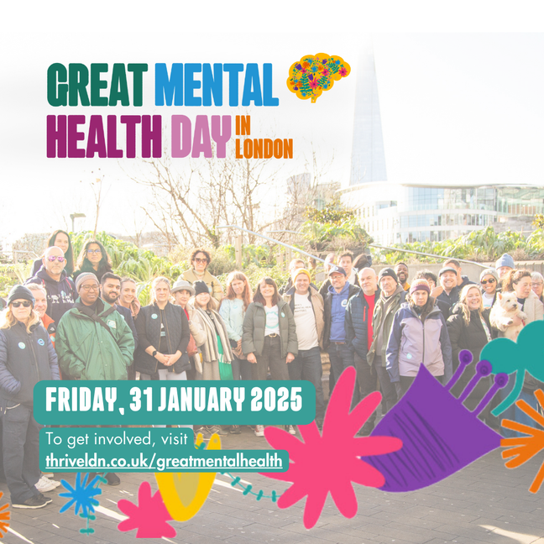
What is Great Mental Health Day?
Great Mental Health Day returns on
Friday, 31 January 2025.
Great Mental Health Day is a London region awareness day to supports Londoners to talk about mental health, create a platform to highlight the great support available, and, crucially, take the stigma out of asking for help when needed.
The day will see Londoners come together across across the city, sharing stories, experiences and exploring ways to support individual and community wellbeing.

Slide 5
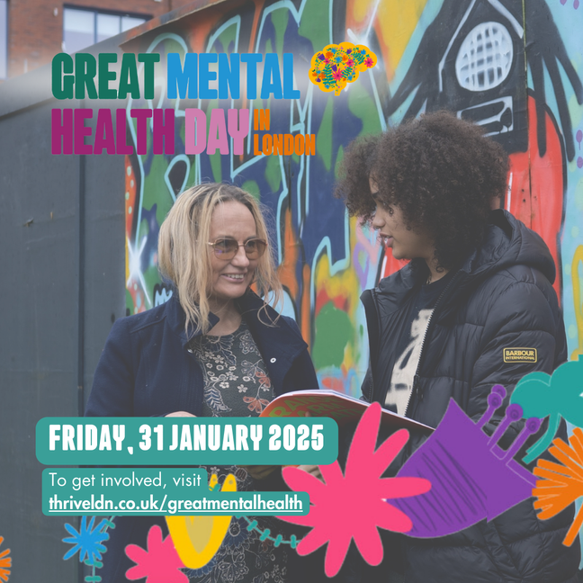
The aims of Great Mental Health Day
Great Mental Health Day aims to offer a shared, regional mental health and wellbeing event for London, that:
  Raises the profile of the mental health services and the great work being done by community and grassroot organisations.
  Destigmatises asking for help, encouraging Londoners to access support available.
  Shares activities that support good wellbeing available both locally and regionally.
  For 2025, explores the conversations around the theme of ‘small actions for others’
  It also acts as a reminder that we can all do our bit to spread hope and kindness, and to help each other.

Slide 6
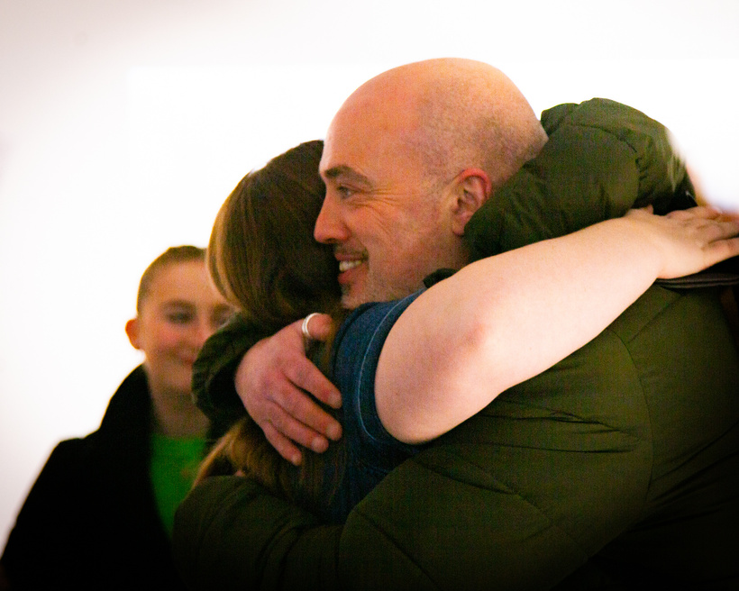
Small actions for others
When times are tough, it’s important that we look after our own and each other's wellbeing. ​
The theme for Great Mental Health Day 2025 is ‘small actions for others’. ​
We all need community. We all need connection. And in a world where those who face the greatest disadvantages in life also face the greatest risks to their mental health, we need these safe spaces more than ever. ​
We want the day to equip and empower Londoners to share and explore ideas around the small actions which contribute to a more supportive, caring, and compassionate community. ​
Great Mental Health Day is therefore an important opportunity to celebrate and learn from the organisations across the region and those in our communities who are devoting energy and compassion to others.

Slide 7
Spreading the word through your networks
Content for digital and print channels to support participation and raise awareness about the day

Slide 8

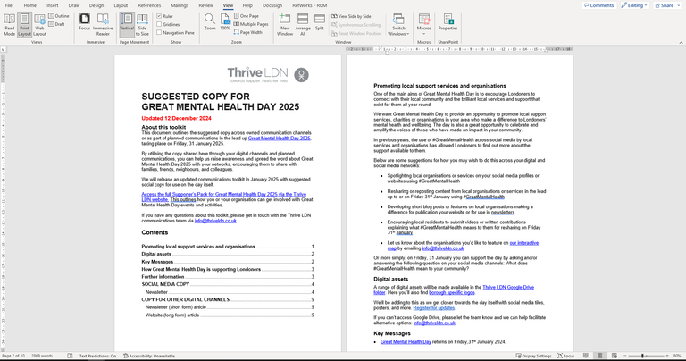
Suggested content to help promote Great Mental Health Day on digital and non-digital channels
One of the easiest ways to get involved with Great Mental Health Day is to let people know about it and share your message of support.
Help us raise awareness about Great Mental Health Day 2025 by spreading the word about the day with your networks - families, friends, neighbours and colleagues. Share your thoughts and plans on social media using #GreatMentalHealth.
We also have put together suggested posts you can share on digital channels. Here you’ll also be able to download the digital assets, such as video content, social media tiles, and more.
We have put together some suggested content for sharing as part of your planned communications - click to access.

Slide 9

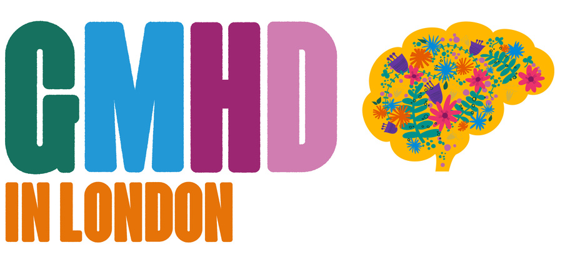




Great Mental Health Day logos
Access and download a range of
Great Mental Health Day logos.
The logos are designed to offer versions across 2 lines (landscape), 4 lines (square), and short (GMHD abbreviated). These versions are then developed as both ‘Great Mental Health Day in London’ but also localised by each borough.

Slide 10
How to get involved
Making the most of Great Mental Health Day for yourself

Slide 11

Find local support near you
Great Mental Health Day 2025 is a London-wide showcase. See what local support and groups are active where you live and get involved with our mission to create more supportive, caring, and compassionate community.
Use the interactive map to explore events, initiatives and support in your area.
This is being constantly updated in the run up to Great Mental Health Day so keep checking back or sign up for more regular updates.

Slide 12

Take free training or join a webinar
Learn more about how you can support the mental health and wellbeing of others in your community through a range of free, online training resources.
You can log on from work or from home to explore a range of training offers, informative webinars, and online workshops, all designed to promote positive mental health and wellbeing.
Please note, most training resources are pre-recorded and available to access anytime. For those which require registration, joining instructions will be sent to your registered email before the event.

Slide 13
Hosting your own event or activity
Tell us about your plans

Slide 14


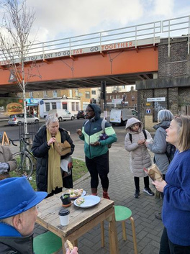
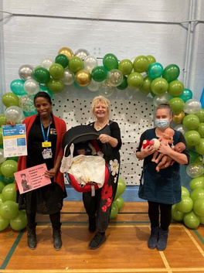

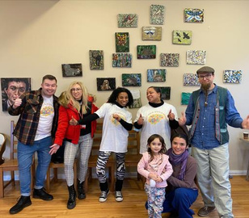
Who can support and be involved with
Great Mental Health Day?
At its core, Great Mental Health Day is created for Londoners, by Londoners. We’re counting on you to help us make the day a success. Ultimately, you know your community best.
In previous years, thousands of Londoners have come together to organise and attend events, share thoughts on social media, create art and promote wellbeing and mental health support resources and services. Those involved ranged from local councils, to grassroots organisations, charities, private companies and individuals.
Anyone can get involved and you can celebrate Great Mental Health Day in whatever way you like - it is entirely up to you.
Just don’t forget to tell us about it or tag us on social media.

Slide 15
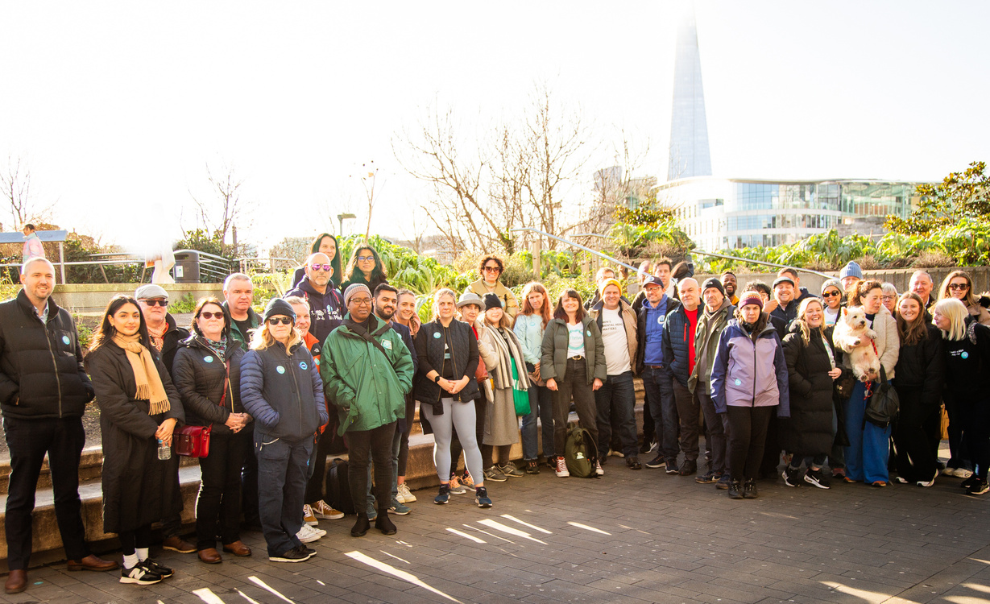
Host your own Great Mental Health Day event or activity
If you or anyone in your local area in London is planning an event or initiative for Great Mental Health Day 2025, we want to know about it.
Fill in the contact form at the bottom of the Great Mental Health Day website or email info@thriveldn.co.uk to tell us all the details about the event or how you’re marking the day. We can promote it on the website and through our other digital channels.
Over the next few pages, we share some ideas some ideas for celebrating Great Mental Health Day as well as examples of how Londoners have marked GMHD in the past.

Slide 16
Planning an event or activity
Great Mental Health Day is a perfect opportunity to highlight activities and wellbeing support services taking place across your local area or borough.
Whether you’d like to run a taster session to promote your wellbeing activity or organisation, or welcome some new faces to your local group, or just meet some of your neighbours for the first time, then Great Mental Health Day is for you.
Thrive LDN’s interactive map lists GMHD events, resources and initiatives across London’s boroughs. Getting your event registered on the map is easy. Just email info@thriveldn.co.uk with the event details, including how to join and a bit about you or your organisation.
Not able to host an activity? No problem! You could offer to host a stall promoting your organisation at someone else's activity. Find activities near you using the London map.
When planning your event you might want to think about:
  Do you have any events already happening in your area that you could hold on Great Mental Health Day?
  Do you run a local support service or offer for the community you’d like to promote on the day?
  Try and make your event inclusive. Events should be free to attend where possible and accessible.
  What do you do to keep yourself well or happy? Is this something you can teach or share with others?

Slide 17
Sharing existing resources and initiatives
Celebrating Great Mental Health Day doesn’t have to involve hosting an event or activity. One of the aims of the day is to raise the profile of the good work community organisations, charities, local authorities and health partners are doing to support good wellbeing locally and regionally.
We know there are lots of helpful resources, projects and initiatives already taking place right across London. Great Mental Health Day is a perfect opportunity to share and promote these.
Use Great Mental Health Day as an opportunity to share and promote resources and ongoing initiatives in your local area.
Ideas for sharing resources and initiatives:
  If there’s weekly newsletter or staff email at your workplace, you could use this to share online resources to support wellbeing.
  Promote existing organisations or groups with people in your local area, for example through a Facebook group or WhatsApp chat.
  Using a regular coffee morning or activity you already do to discuss mental health and wellbeing on Great Mental Health Day.
  Sharing links to helpful resources and activities on social media. Explore some from the Thrive LDN or Good Thinking websites.

Slide 18
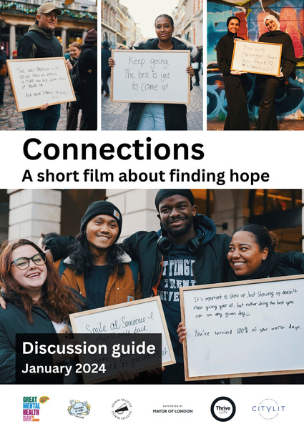
Connections - a short film
Use Connections from GMHD 24 as a free film and resource for your community, school or workplace.
Filmed across three days in central London, the Connections film project was the innovative idea of Beth Evans founder of Messages of Hope with support from Thrive LDN and Speakers Collective.
The short film invited people of all ages to write a message of hope for someone who may be finding things difficult.
For Great Mental Health Day 2024, we’d encourage everyone to consider using the Connections film and resources as a conversation starter for your community, school, workplace or local group.
In any talk about suicide prevention, we strongly recommend that signposting is included to support services including Samaritans, SHOUT and the Hub of Hope.
Using Connections for your community
1. Download a Connections Film – Discussion Guide, aimed to support you screen the film with groups. The group activity will take around 45-60 minutes depending on the depth of discussion.
2. Download a series of Meg Ellis’ still
images taken during the making of the
film. Display these in an accessible place,
and provide space for people to write
their own messages of hope.
3. Download the Connections colouring
pages and print to encourage people
to take part and interact.

Slide 19
Previous Great Mental
Health Days
How Londoners have celebrated Great Mental Health Day locally in previous years

Slide 20
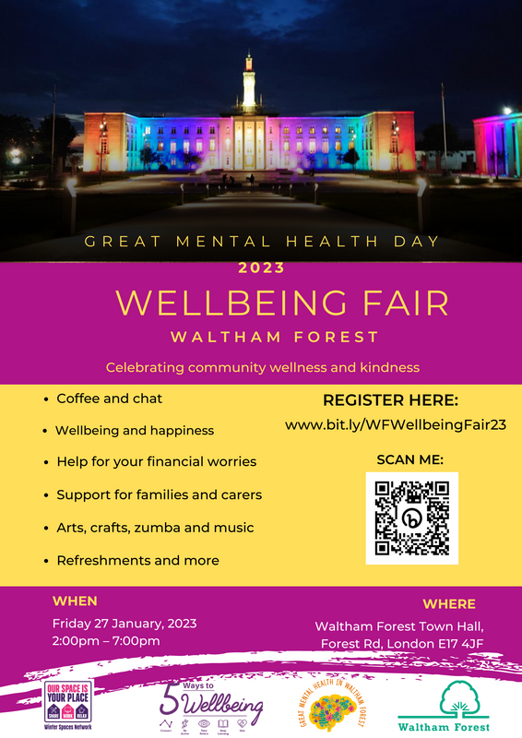
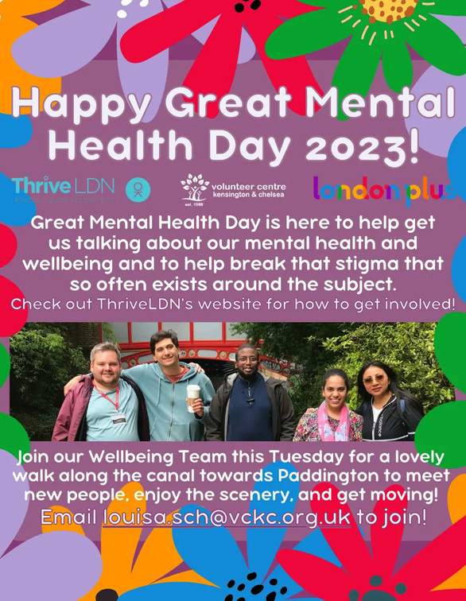
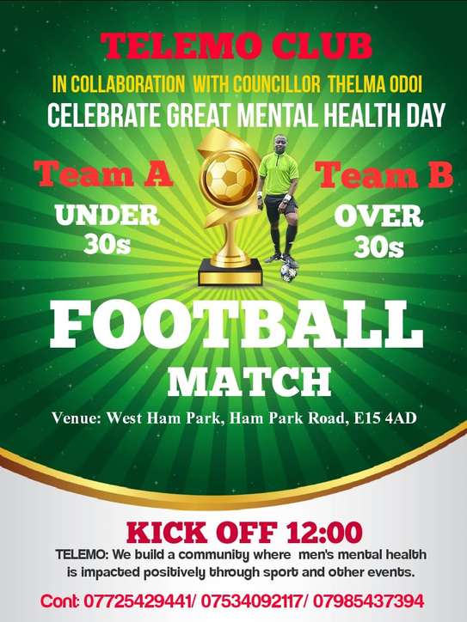
How London boroughs and others have previously celebrated Great Mental Health Day

Slide 21
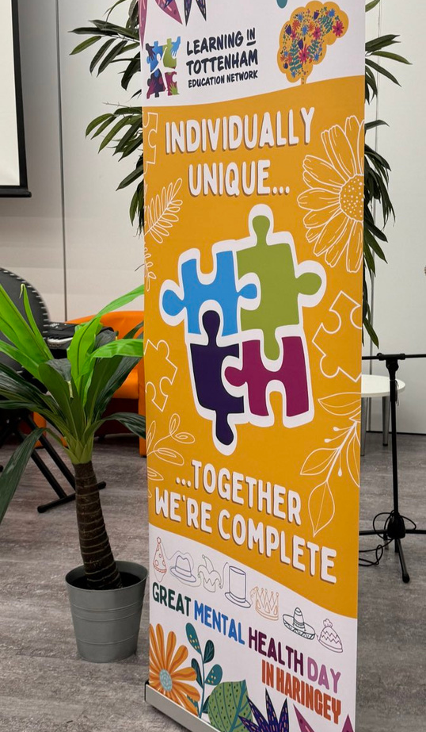
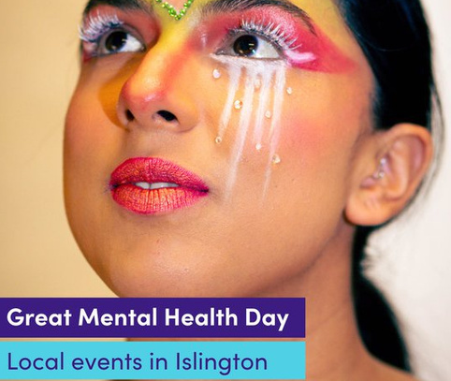

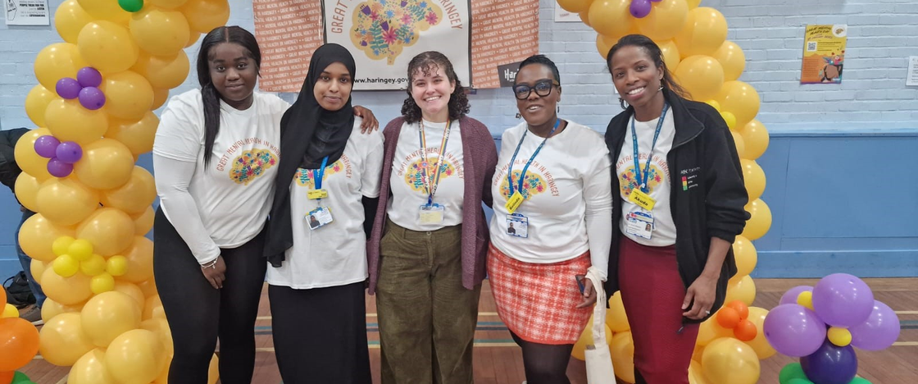

Slide 22
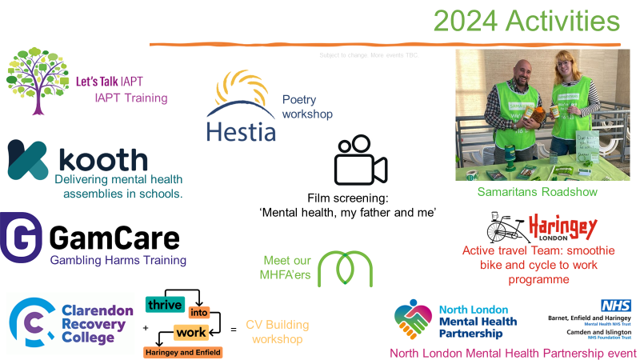

Slide 23
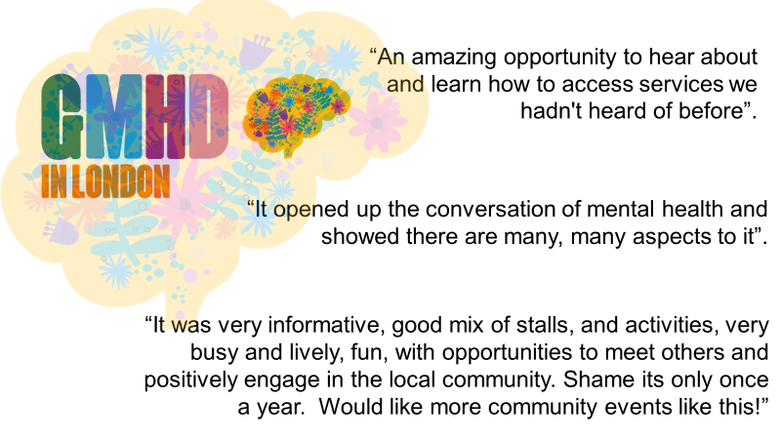
Impact of Great Mental Health Day events on
residents and communities

Slide 24
Actions and next steps

Slide 25
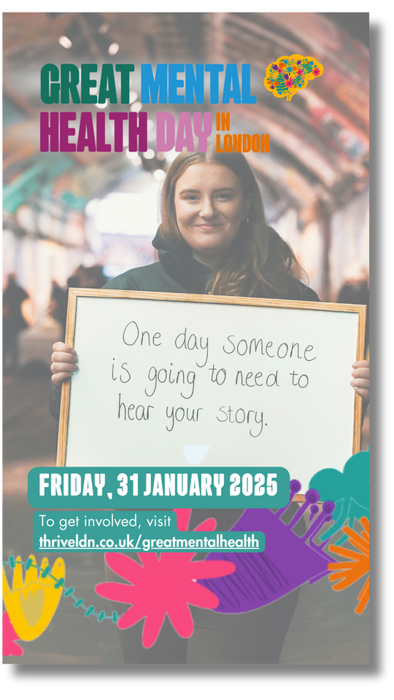
Actions you can take now…
We hope this pack gives you lots of ideas for how you might get involved with Great Mental Health Day, both leading up to the day or on Friday, 31 January 2025 itself.
Here are four things you can do now to get the most of the day:
1. Let people know it’s happening. One of the easiest ways to get involved with Great Mental Health Day is to let people know about it and share your message of support. Download the communications toolkit which contains suggested social, newsletter and website copy.​
2. Use the day to raise awareness about local services and support. Encourage residents to find out more about local organisations, charities or services in the local area. Use blog posts, website features or social media posts to promote these on or around Great Mental Health Day.

Slide 26
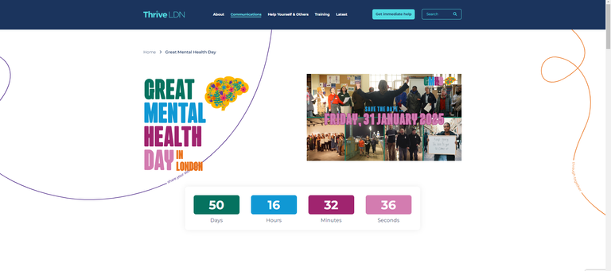
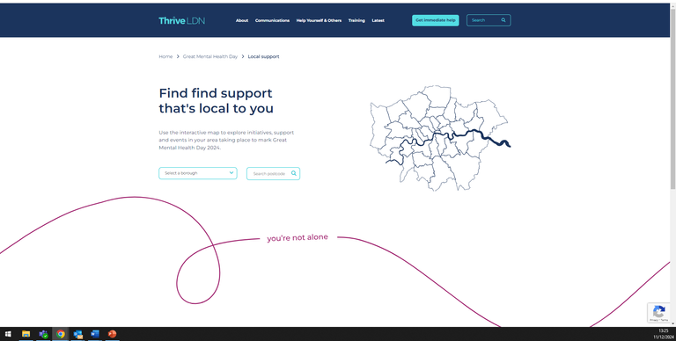
Actions you can take now…
3. Signpost to free online training offers and resources. We want to encourage Londoners to access the free training and support offers available to them. You can access these via the Thrive LDN website and we've collated key resources into one place.​
4. Tell us about your Great Mental Health Day 2025 plans! Let us know about any events that are taking place locally or any services or support you would like to add to the interactive GMHD map.

Slide 27

Key dates for your diary
Tuesday, 17 December 2024 and Tuesday, 21 January 2025​
London Public Mental Health Communications Group meetings​
Join us for an opportunity to check in with colleagues ahead of the day and share plans at our next two meetings. Please email info@thriveldn.co.uk for a meeting link if you’d like to join.​
​Between Wed 18 December – Fri 17 January (rolling)​
Email info@thriveldn.co.uk to include any local services, organisations, training opportunities or events to the interactive map. We'll update these pages on a rolling basis.​​
Friday, 31 January​
Great Mental Health Day 2025!

Slide 28
Appendix

Slide 29




Who is behind Great Mental Health Day?
Thrive LDN is a citywide public mental health partnership to ensure all Londoners have an equal opportunity for good mental health and wellbeing. We are a coalition of partners working towards the shared mission of ensuring everyone living or working in London is treated fairly and can live a happy
and healthy life.
Good Thinking is an online service that supports Londoners to look after their mental health and wellbeing in a way that works for them. Available 24/7 on any device and completely anonymous, Good Thinking provides a range of advice, resources and NHS-approved apps, to help Londoners improve
their mental wellbeing.
The London Borough of Haringey developed the original framework for Great Mental Health Day as a local awareness day in 2021. They continue to support the co-development of GMHD 2023 both locally and regionally.
The day is also supported by the Mayor of London, the NHS in London, London boroughs and the Association of Directors of Public Health London, London Councils, and OHID in London.
Great Mental Health Day - 31st January 2025

Slide 30

Frequently asked questions
Still got a burning question?
Then explore our FAQs.
Have another question not listed there or explained in this Supporter’s Pack?
Then speak to the Thrive LDN team. You can contact us and we will get back to you to have a chat through your plans and ideas.
Great Mental Health Day - 31st January 2025

